Slide 1

Model to Predict Churn in Syriatel
Yasitha De Alwis

Slide 2

Objective
Model to predict customer churn

Slide 3
Modelling Approach
No of Records : 3333
Training Data 2499
Testing Data 834
No of Variables : 21
Numerical Data : 17
Categorical Data : 4
Model used : Logistic Regression
Response Variable : churn with True or False response

Slide 4
Model Effectiveness Indicators
Model | Train Score | Test Score | Train logloss | TesT Logloss | CV with F1 scoring | Recall | F1 Score
Dummy Model | 0.8667 | 0.8501 | 4.9479 | 5.1767 | 0.0000 | 0.00 | 0.00
Logistic Regression without SMOTE | 0.8735 | 0.8573 | 0.3112 | 0.3270 | 0.3131 | 0.20 | 0.30
Logistic Regression with SMOTE | 0.7771 | 0.7746 | 0.4989 | 0.5008 | 0.4611 | 0.77 | 0.51
Log with Poly Feature | 0.8575 | 0.8489 | 0.3489 | 0.3668 | 0.5553 | 0.80 | 0.61
gs model* | 0.9084 | 0.8909 | 0.2395 | 0.3214 | 0.5921 | 0.74 | 0.67
*gs model - Logistic with Poly Feature with hyperparameter adjustments

Slide 5
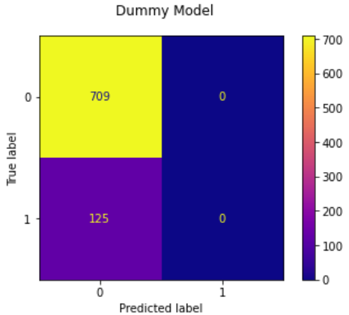
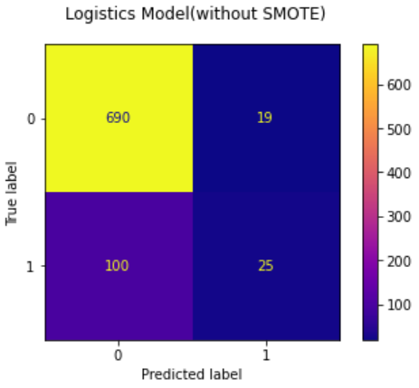
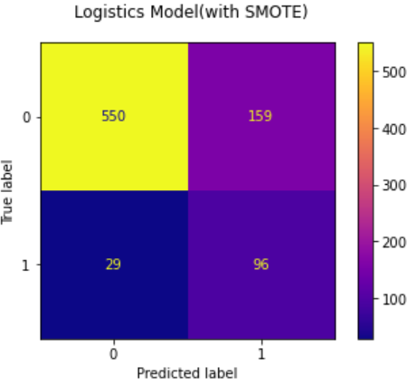
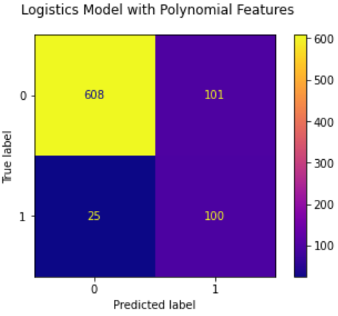
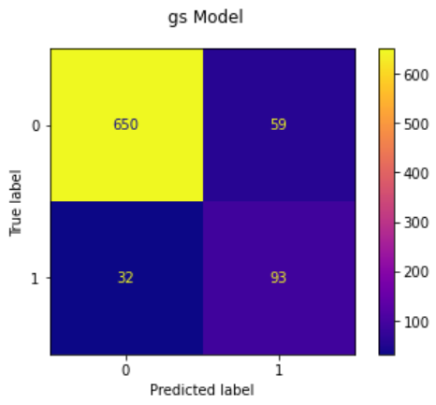

Model Effectiveness : Confusion Matrix
85%
86%
77%
125
119
188
F-Score 0
F-Score 0.52
85%
89%
126
91
F-Score 0.62
F-Score 0.67

Slide 6
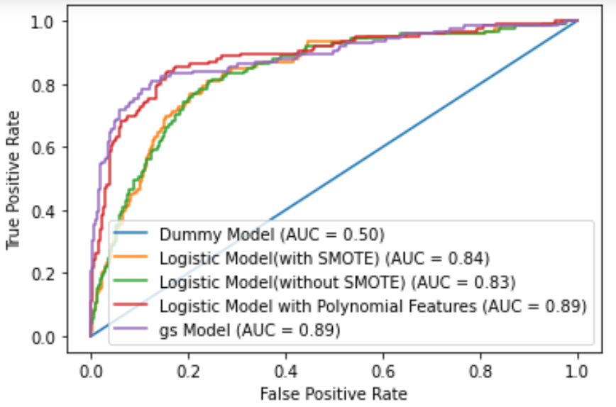
ROC curve
Model Effectiveness : Area Under the Receiver Operating Characteristic Curve

Slide 7

Recommendation
Logistic Regression Model with Polynomial Feature
Imputer strategy : mean
Degree of Polynomial :3
C = 1
Solver = liblinear
Tolerance : 0.0001
No of iterations = 100

Slide 8
Model Usage
phone number | Predicted Churn
382-4657 | 0
371-7191 | 0
358-1921 | 1
375-9999 | 0
330-6626 | 0
Develop Strategies for
Customer Retention
Personalize Engagement
Customer Satisfaction

Slide 9

Next steps
Validate the model using expanded data set
Use other classification models
Implement the model in user friendly environment

Slide 10

Thank You

